Slide 1
Ambient Occlusion
Global illumination technique to calculate ambient lighting
Computes the level of occlusion for each point in a scene based on surrounding geometetry
Usable in indoor and outdoor environments
Used in different forms for both real-time and offline rendering.

Slide 2
The crudest form
Define a hemisphere over each point.
For all possible directions check wether the point is occluded or not
This gives a total occlusion for the point
$$A_{\overline{p}}=1−\frac{1}{π}\int_{Ω}{V_{\overline{p},\hat{ω}}(}\hat{ω})dω$$
Can be expanded in countless ways
Bent normals
Attenuation
Color calculations
Weighted distributions etc.

Slide 3
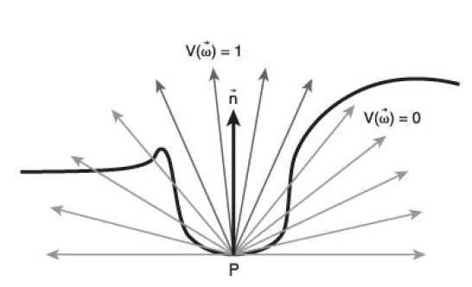

Slide 4
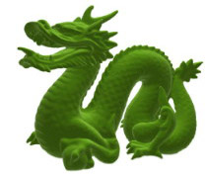
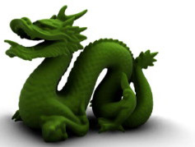

Slide 5
Screen Space AO
Developed by Vladimir Kajalin at Crytek and used for the first time in the original Crysis, 2007
Primarily uses the depth buffer to calculate the occlusion
Samples and calculates AO for each pixel on the screen.
Positives: Removes load from CPU. Performance independant from scene complexity. Works for dynamic objects.
Negatives: Local and view-dependent. Creates noise that is hard to blur correctly. Objects outside the screen are not considered

Slide 6
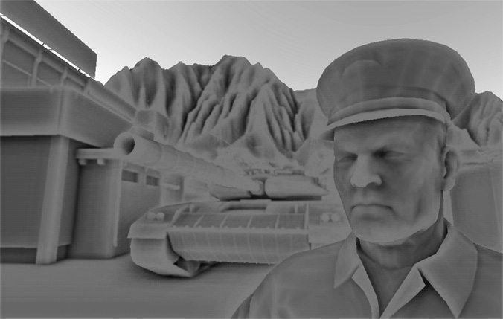

Slide 7
Horizon Based SSAO
Developed by Louis Bavoil and Miguel Sainz at nvidia and presented in 2008
Observation: sampling is done in a lot of directions where don’t expect to find occluding objects
The main idea is to do horizonbased culling to reduce the directions we have to check for occlusions.
Requires depth buffer and per-pixel normals

Slide 8
Defining the hemisphere
We use spherical coordinate system to get samples for the point
Instead of orienting by the points normal we orient towards the camera position.
We then split this sphere with a tangent plane and a horizon angle to limit the area where we look for occluding objects.

Slide 9
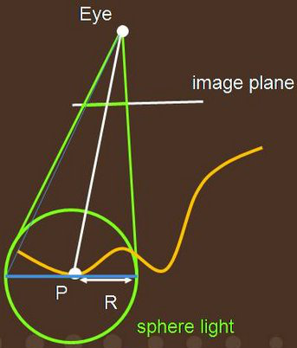
Defining the hemisphere
Defined in eye-space and transformed into image space in the shape of a disc

Slide 10
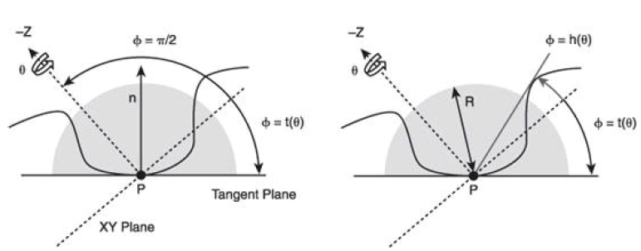
Defining the hemisphere
We can now define the AO function as follows:
$$A_{\overline{p}}=1−\frac{1}{2π}\int_{Θ=−π}^{π}{\int_{Φ=t(Θ)}^{h(Θ)}{cos(Φ)}}dΦdΘ$$

Slide 11
The horizon angle
March on the heightfield
Ignore samples below the horizon angle

Slide 12
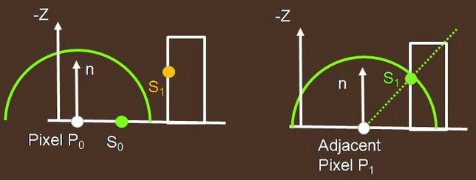
Discontinuity problem
Large AO difference between P0 and P1
Solved by an attenuation function!

Slide 13
Attenuation function
We introduce a function
$W\left(r\right)=1−r^{2}$
where r, is the distance to the occluder normalized to the radius of the hemisphere
This introduces a falloff reducing the ambient occlusion impact of distant objects.
$$A_{\overline{p}}=1−\frac{1}{2π}\int_{Θ=−π}^{π}{\int_{Φ=t(Θ)}^{h(Θ)}{W\left(\hat{ω}\right)cos(Φ)}}dΦdΘ$$

Slide 14
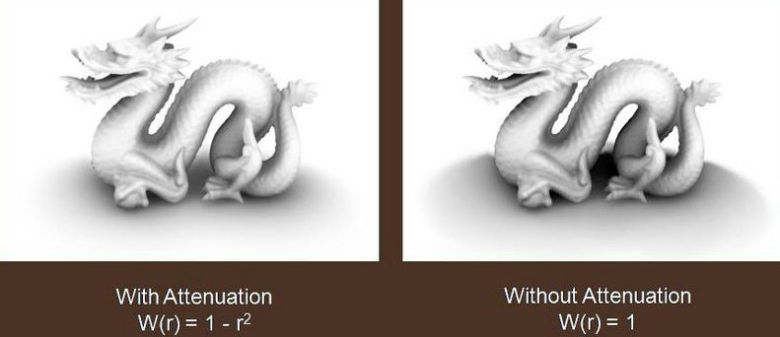

Slide 15
The HBAO function
By sampling along a line on the image and skipping the samples that do not increase the horizon angle we get a partitioning of the elevation angles
$$\int_{Φ=t(Θ)}^{h(Θ)}{W\left(\hat{ω}\right)cos(Φ)dΦ}=\sum_{i=1}^{N_{s}}{\int_{Φ= Φ_{i−1}}^{Φ_{i}}{W\left(\hat{ω}\right)\cos\left(Φ\right)dΦ}}$$
$$A_{\overline{p}}=1−\frac{1}{2π}\int_{Θ=−π}^{π}{\sum_{i=1}^{N_{s}}{\int_{Φ= Φ_{i−1}}^{Φ_{i}}{W\left(\hat{ω}\right)\cos\left(Φ\right)dΦ}}}$$

Slide 16
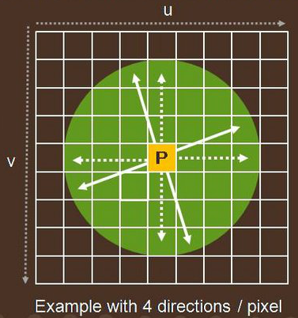
Directions and Jittering
Uniform distribution of directions per pixel and fixed number of samples per direction
To avoid banding artifacts rotate the directions randomly and jitter the samples per direction
Introduces noise which we have to handle.

Slide 17
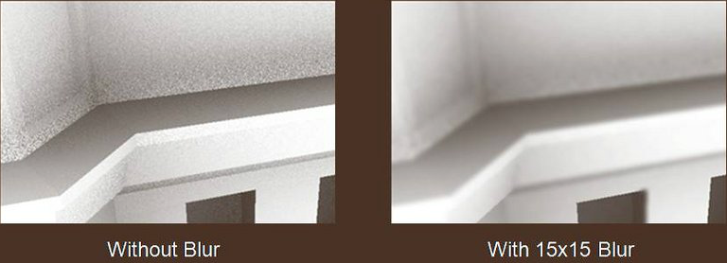
Blurring the noise
Important to make sure we don’t have occlusion bleeding.
Use depth dependant gaussian blur: Cross-bilateral filtering
Reduces blurring at edges

Slide 18
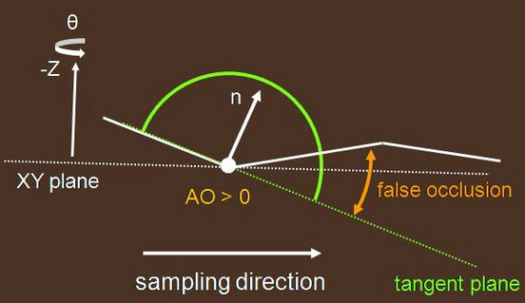
Low tessalation and creases
If the tesselation in a scene or around particular objects is low or the point were sampling is in a crease we can get false occlusion

Slide 19
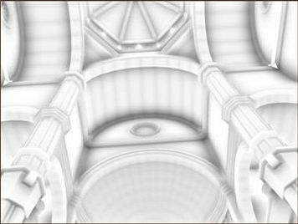

Slide 20
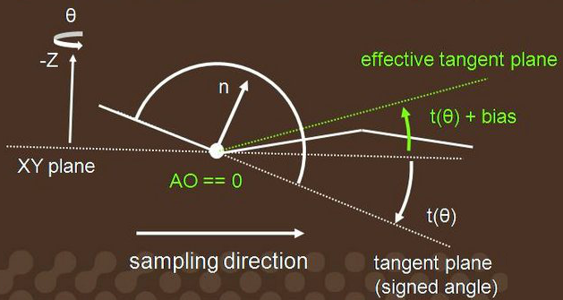
Introduce angle bias
To solve this we introduce an angle bias used to offset the tangent plane.

Slide 21
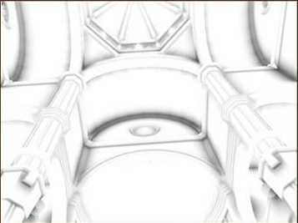

Slide 22
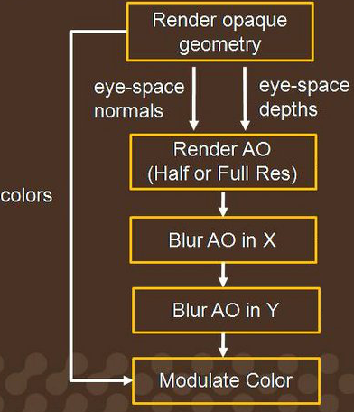
Final Rendering Pipeline

Slide 23
Issues
As usual for screen space based algorithms we have no information outside of the screen.
Still relatively computationally intensive.
Often used at half ambient occlusion map resolution

Slide 24
Demo video

Slide 25
Questions?

